Slide 1


Content
01
1.25G T1550/R1310nm 20km BIDI SFP
08
10Gb/s 40km SFP+
02
1.25G T1550/R1310nm 40km BIDI SFP
09
10Gb/s 80km SFP+ With DDM
03
1.25G T1550/R1490nm 80km BIDI SFP
10
10Gb/s 40km SFP+With DDM
04
10G Tx1270/Rx1330nm 20km BIDI SFP+
11
100G QSFP28 10km LR4
05
10Gb/s 850nm 300m SFP+
12
100GBase QSFP28 ER4 40KM
06
10Gb/s 20km SFP+
13
1.25G T1310/R1550nm 20km BIDI SFP With DDM
07
10Gb/s 80km SFP+
14
1.25G T1490/R1550nm 80km BIDI SFP With DDM

Slide 2

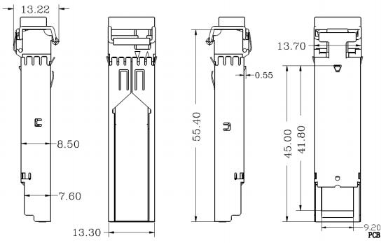
01
1.25G T1550/R1310nm 20km BIDI SFP
02
1.25G T1550/R1310nm 40km BIDI SFP
DESCRIPTION
DESCRIPTION
Feature: Up to 1.25Gbps operation 1550nm DFB laser and PIN photodetector for 40km transmission Compliant with SFP MSA and SFF-8472 with simplex LC receptacle Digital Diagnostic Monitoring Compatible with SONET OC-24 +3.3V single power supply RoHS compliant (lead free) Operating case temperature: Commercial:0 to 70 °C Industrial:-40 to 85 °C
Type:
Feature: ➢Up to 1.25Gbps operation ➢1550nm DFB laser and PIN photodetector for 20km transmission ➢Compliant with SFP MSA and SFF-8472 with simplex LC receptacle ➢Digital Diagnostic Monitoring ➢Compatible with SONET OC- ➢+3.3V single power supply ➢RoHS compliant (lead free) ➢Operating case temperature: Commercial:0 to 70 °C Industrial:-40 to 85 °C Type:
PartNumber | ProductDescription
VR-PEE422L-ID | BIDISFP, 1.25Gbps, Tx1550/Rx1310nm, SM, 20km, -40ºC~+85ºC, WithDDM
VR-PEE422L-SD | BIDISFP, 1.25Gbps, Tx1550/Rx1310nm, SM, 20km, 0ºC~+70ºC, WithDDM
PartNumber | ProductDescription
VR-PEE424L-ID | BIDISFP, 1.25Gbps, Tx1550/Rx1310nm, SM, 40km, -40ºC~+85ºC, WithDDM
VR-PEE424L-SD | BIDISFP, 1.25Gbps, Tx1550/Rx1310nm, SM, 40km, 0ºC~+70ºC, WithDDM
01 VERICH PRODUCT BROCHURE
VERICH PRODUCT BROCHURE 02

Slide 3

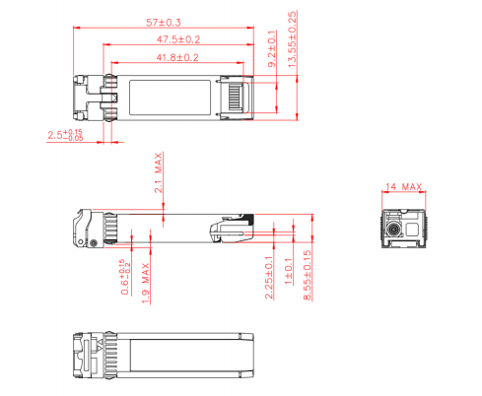
03
1.25G T1550/R1490nm 80km BIDI SFP
04
10G Tx1270/Rx1330nm 20km BIDI SFP+
DESCRIPTION
DESCRIPTION
Feature:
Up to 1.25Gbps operation
1550nm DFB laser and PIN photodetector for 80km transmission
Compliant with SFP MSA and SFF-8472 with simplex LC receptacle
Digital Diagnostic Monitoring
Compatible with SONET OC-
+3.3V single power supply
RoHS compliant (lead free)
Operating case temperature:
  Commercial:0 to 70 °C
  Industrial:-40 to 85 °C
Type:
Feature:
Hot Pluggable
Single LC interface, Duplex operation
1270nm/1330nm DFB transmitter, PIN receiver
Power consumption <1W
Applicable for 20km SMF connection
Single +3.3V power supply
All-metal housing for superior EMI performance
Cost effective SFP+ solution, enables higher port densities and greater bandwidth
Operating Temperature: 0 to +70°C -40 to +85°C
RoHS compliant (lead free)
Type:
PartNumber | ProductDescription
VR-PEE438L-ID | BIDISFP, 1.25Gbps, Tx1550/Rx1490nm, SM, 80km, -40ºC~+85ºC, WithDDM
VR-PEE438L-SD | BIDISFP, 1.25Gbps, Tx1550/Rx1490nm, SM, 80km, 0ºC~+70ºC, WithDDM
PartNumber | ProductDescription
VR-PII562L-ID | SFP+ BIDITx1270/Rx1330nm, 10.3125Gbps, SM, 20km, -40ºC~+85ºC, WithDDM
VR-PII562L-SD | SFP+ BIDITx1270/Rx1330nm, 10.3125Gbps, SM, 20km, 0ºC~+70ºC, WithDDM
VR-PII652L-ID | SFP+ BIDITx1330/Rx1270nm, 10.3125Gbps, SM, 20km, -40ºC~+85ºC, WithDDM
VR-PII652L-SD | SFP+ BIDITx1330/Rx1270nm, 10.3125Gbps, SM, 20km, 0ºC~+70ºC, WithDDM
03 VERICH PRODUCT BROCHURE
VERICH PRODUCT BROCHURE 04

Slide 4

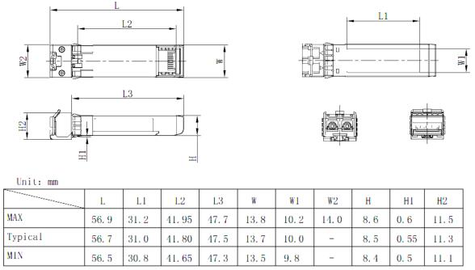
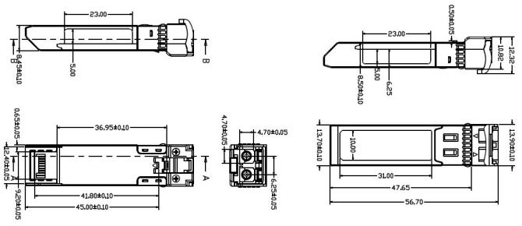
05
10Gb/s 850nm 300m SFP+
06
10Gb/s 20km SFP+
DESCRIPTION
DESCRIPTION
Feature:
Hot Pluggable
LC Duplex optical interface
1310nm DFB transmitter, PIN receiver
Low power consumption
Applicable for 20km SMF connection
All-metal housing for superior EMI performance
Advanced firmware allow customer system encryption Information to be stored in transceiver
Cost effective SFP+ solution, enables higher portdensities and greater bandwidth
Operating Temperature:0 to +70°C -40 to +85°C
RoHS compliant (lead free)
Type:
Feature:
Hot Pluggable
LC Duplex optical interface
850nm VCSEL transmitter, PIN receiver
Low power consumption
All-metal housing for superior EMI performance
Advanced firmware allow customer system encryption
Information to be stored in transceiver
Cost effective SFP+ solution, enables higher port densities and greater bandwidth
Operating case temperature: 0 to 70 °C -40 to 85 °C
RoHS compliant (lead free)
Type:
PartNumber | ProductDescription
VR-PII110L-SD | SFP+, 10.3125Gbps, 850nm, MM, 300m, 0ºC~+70ºC, WithDDM
VR-PII110L-ID | SFP+, 10.3125Gbps, 850nm, MM, 300m, -40ºC~+85ºC, WithDDM
PartNumber | ProductDescription
VR-PII222L-ID | SFP+, 10.3125Gbps, 1310nm, SM, 20km, -40ºC~+85ºC, WithDDM
VR-PII222L-SD | SFP+, 10.3125Gbps, 1310nm, SM, 20km, 0ºC~+70ºC, WithDDM
05 VERICH PRODUCT BROCHURE
VERICH PRODUCT BROCHURE 06

Slide 5
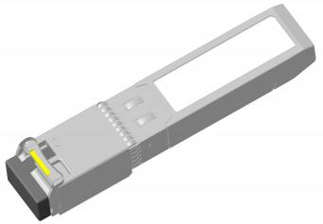
07
10Gb/s 80km SFP+
08
10Gb/s 40km SFP+
DESCRIPTION
DESCRIPTION
Feature:
• Hot Pluggable
• Single LC interface, Duplex operation
• 1490nm/1550nm EML transmitter, APD receiver
• Power consumption <2W
• Applicable for 80km SMF connection
• Single +3.3V power supply
• All-metal housing for superior EMI performance
• Cost effective SFP+ solution, enables higher port densities and greater bandwidth
• Operating case temperature: Commercial:0 to 70 °C Industrial:-40 to 85 °C
• RoHS compliant (lead free)
Type:
Feature:
Hot Pluggable
LC Duplex optical interface
1550nm cooled EML transmitter, PIN receiver 1.2G to 11.3G bit rates
Low power consumption<1.5W
Up to 40km SMF length
All-metal housing for superior EMI performance
Cost effective SFP+ solution, enables higher port densities and greater bandwidth
Operating Temperature: 0 to +70°C -40 to +85C
RoHS compliant (lead free)
Type:
PartNumber | ProductDescription
VR-PII348L-SD | SFP+ BIDITx1490/Rx1550nm, 10.3125Gbps, SM, 80km, 0ºC~+70ºC, With DDM
VR-PII348L-ID | SFP+ BIDITx1490/Rx1550nm, 10.3125Gbps, SM, 80km, -40ºC~+85ºC, With DDM
VR-PII438L-SD | SFP+ BIDITx1550/Rx1490nm, 10.3125Gbps, SM, 80km, 0ºC~+70ºC, With DDM
VR-PII438L-ID | SFP+ BIDITx1550/Rx1490nm, 10.3125Gbps, SM, 80km, -40ºC~+85ºC, With DDM
PartNumber | ProductDescription
VR-PII444L-XD | SFP+, 10.3125Gbps, 1550nm, SM, 40km, 0ºC~+70ºC, WithDDM
 | SFP+, 10.3125Gbps, 1550nm, SM, 40km, -40ºC~+85ºC, WithDDM
07 VERICH PRODUCT BROCHURE
VERICH PRODUCT BROCHURE 08

Slide 6
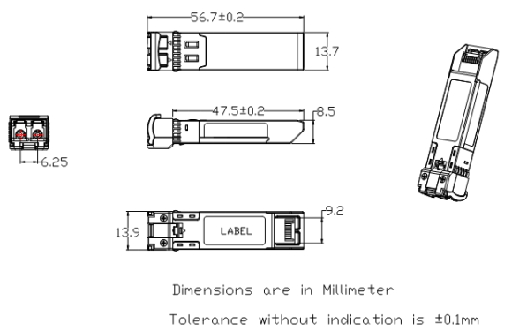
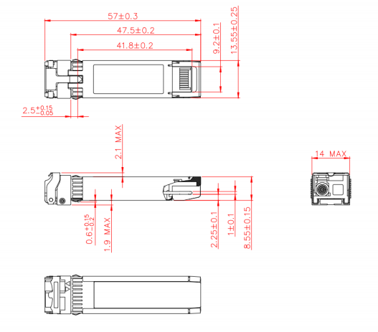
09
10Gb/s 80km SFP+ With DDM
10
10Gb/s 40km SFP+With DDM
DESCRIPTION
DESCRIPTION
Feature:
Supports 9.95 to 11.3Gb/s bit rates with Dual CDR Industrial:-40 to 85°C
Duplex LC connector
Hot pluggable SFP+ footprint
Cooled 1550nm EML transmitter, APD receiver
Applicable for 80km SMF connection
Low power consumption, < 1.5W
Digital Diagnostic Monitor Interface
Optical interface compliant to IEEE 802.3ae 10GBASE-ZR
Electrical interface compliant to SFF-8431 ，SFF-8432
Operating case temperature: Commerical:0 to 70 °C
Type:
Feature:
Hot Pluggable
Single LC interface, Duplex operation
1270nm/1330nm DFB transmitter, PIN receiver
Operating case temperature: 0 to 70 °C
Power consumption <1W
Applicable for 40km SMF connection
Single +3.3V power supply
All-metal housing for superior EMI performance
Cost effective SFP+ solution, enables higher port densities and greater bandwidth
RoHS compliant (lead free)
Type:
PartNumber | Description
VR-PII448L-SD | SFP+,9.95 to11.3Gb/s, 1550nmEML,80km, 0~70C, withDigitalDiagnosticMonitor
VR-PII448L-ID | SFP+,9.95 to11.3Gb/s, 1550nmEML,80km, -40~85C, withDigitalDiagnosticMonitor
PartNumber | ProductDescription
VR-PII564L-ID | SFP+ BIDITx1270/Rx1330nm, 10.3125Gbps, SM, 40km, -40ºC~+85ºC, WithDDM
VR-PII564L-SD | SFP+ BIDITx1270/Rx1330nm, 10.3125Gbps, SM, 40km, 0ºC~+70ºC, WithDDM
VR-PII654L-ID | SFP+ BIDITx1330/Rx1270nm, 10.3125Gbps, SM, 40km, -40ºC~+85ºC, WithDDM
VR-PII654L-SD | SFP+ BIDITx1330/Rx1270nm, 10.3125Gbps, SM, 40km, 0ºC~+70ºC, WithDDM
09 VERICH PRODUCT BROCHURE
VERICH PRODUCT BROCHURE 10

Slide 7
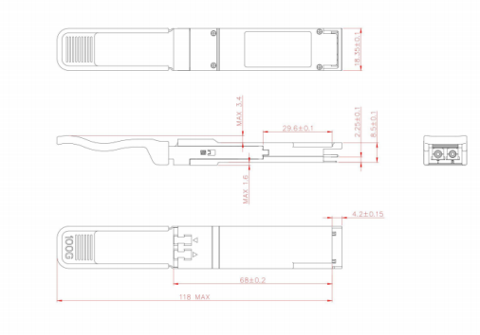
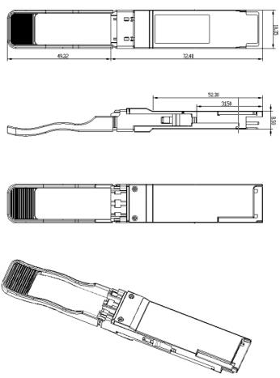
11
100G QSFP28 10km LR4
12
100GBase QSFP28 ER4 40KM
DESCRIPTION
DESCRIPTION
Feature:
4 Independent LAN-WDM channels
Low Power Consumption <4W
Wide Operating Temperature(0°C~70°C)
Maximum link length of 10km via Single Mode Fiber (SMF)
Type:
VR-QKKLL1L-SD:
100GBASE LR4 100G Ethernet
High performance computing, data com and sever data links
High speed access
Feature:
Hot Pluggable QSFP28 form factor
Supports aggregate bit rate up to 103.125Gb/s
LC Duplex optical interface
4x25Gb/s LAN-WDM transmitter, EML laser,APD array detector
Operating case temperature:0 to 70 °C
Low power consumption <4.5W
Applicable for 40km SMF connection without FEC
All-metal housing for superior EMI performance
IIC management interface
Single +3.3V power supply
RoHS compliant (lead free)
Type:
PartNumber | ProductDescription
VR-QKKLL4L-SD | QSFP28, 100Gbps,ER4, SM, 40km, 0ºC ~ +70ºC, With DDM
11
VERICH PRODUCT BROCHURE
VERICH PRODUCT BROCHURE 1

Slide 8
13
1.25G T1310/R1550nm 20km BIDI SFP With DDM
14
1.25G T1490/R1550nm 80km BIDI SFP With DDM
DESCRIPTION
DESCRIPTION
Feature:
Up to 1.25Gbps operation
1310nm FP laser and PIN photodetector for 20km transmission
Compliant with SFP MSA and SFF-8472 with simplex LC receptacle
Digital Diagnostic Monitoring
Compatible with SONET OC-
+3.3V single power supply
RoHS compliant (lead free)
Operating case temperature:
  Commercial:0 to 70 °C
  Industrial:-40 to 85 °C
Type:
Feature:
Up to 1.25Gbps operation
1490nm DFB laser and PIN photodetector for 80km transmission
Compliant with SFP MSA and SFF-8472 with simplex LC receptacle
Digital Diagnostic Monitoring
Compatible with SONET OC-
+3.3V single power supply
RoHS compliant (lead free)
Operating case temperature:
  Commercial:0 to 70 °C
  Industrial:-40 to 85 °C
Type:
PartNumber | ProductDescription
VR-PEE242L-ID | BIDISFP, 1.25Gbps, Tx1310/Rx1550nm, SM, 20km, -40ºC~+85ºC, WithDDM
VR-PEE242L-SD | BIDISFP, 1.25Gbps, Tx1310/Rx1550nm, SM, 20km, 0ºC~+70ºC, WithDDM
PartNumber | ProductDescription
VR-PEE348L-ID | BIDISFP, 1.25Gbps, Tx1490/Rx1550nm, SM, 80km, -40ºC~+85ºC, WithDDM
VR-PEE348L-SD | BIDISFP, 1.25Gbps, Tx1490/Rx1550nm, SM, 80km, 0ºC~+70ºC, WithDDM
13 VERICH PRODUCT BROCHURE
VERICH PRODUCT BROCHURE 14

